Slide 1

Next Steps: Implementing the MOU at the
Campus Level
New Hanover County Schools
Judy Stubblefield
Student Support Services
February 16, 2016

Slide 2
Tools we use are key to implementation
ABE system
PBIS
Bullying Prevention

Slide 3


Slide 4
What is ABE?
ABE is an electronic behavior data management system that collects district-wide data necessary for vertical reporting. Automated graphs provide detailed data revealing problematic areas and areas of improvement.
We are able to gain more control with the ability to track statistics on individual schools across the district.
By using ABE, we are able to demonstrate the high priority placed on behavior and social education.

Slide 5
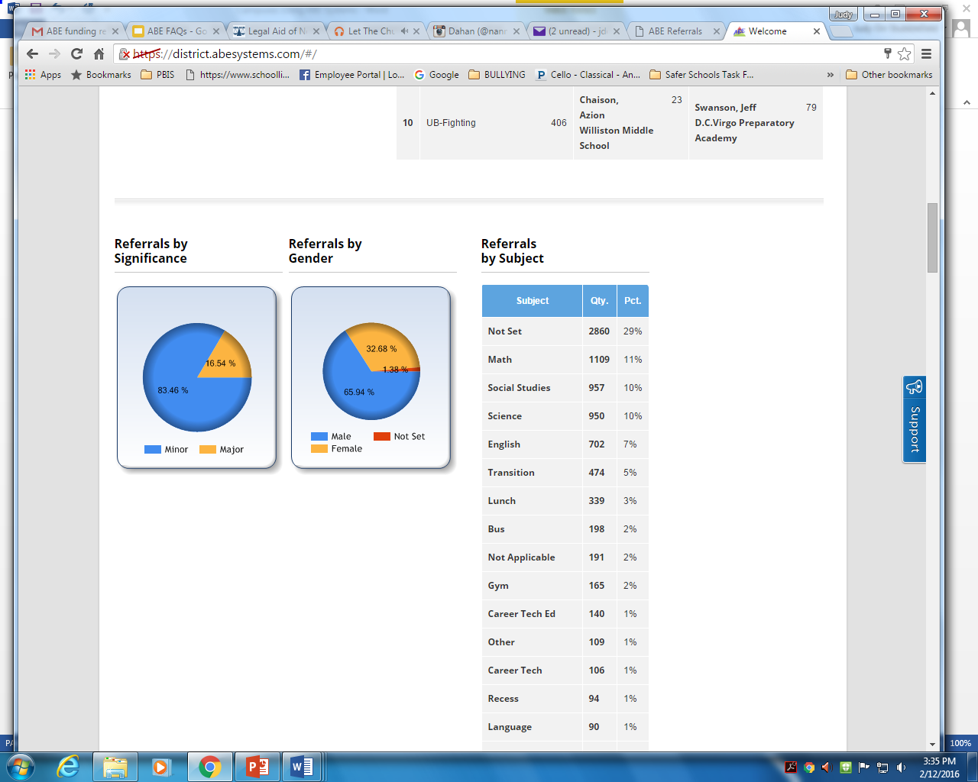
District Statistics
What we get to see!
Active Students in District | 20418
Students with Referrals | 3042
% Student with Referrals | 8%
Avg. Referrals / Students | 0.3
Students with Interventions | 975
% Students with Interventions | 3%
Avg. Interventions / Student | 0.1
Total Referrals | 9997
- With Interventions | 1068
- Without Interventions | 8929
Total Interventions | 1882

Slide 6
Features
Electronic Referrals - These automatically populate in the Administrator’s queue and
teachers are aware as soon as action is taken. Referrals can be made to Counselors.
Elementary,Middle/High School Interventions - Interactive or Paper
School Wide Behavior Statistics - Daily updates available to view entire district
Behavioral Exchange Game - Allows students to gain points for positive behaviors
My Classroom - Teachers can see behaviors of their students in all classes in one glimpse
Functional Behavior Assessment - FBA
Behavior Improvement Plan - BIP - Automatically populated from FBA
Parent Portal - Currently used to generate letters for parents after interventions
are done.

Slide 7
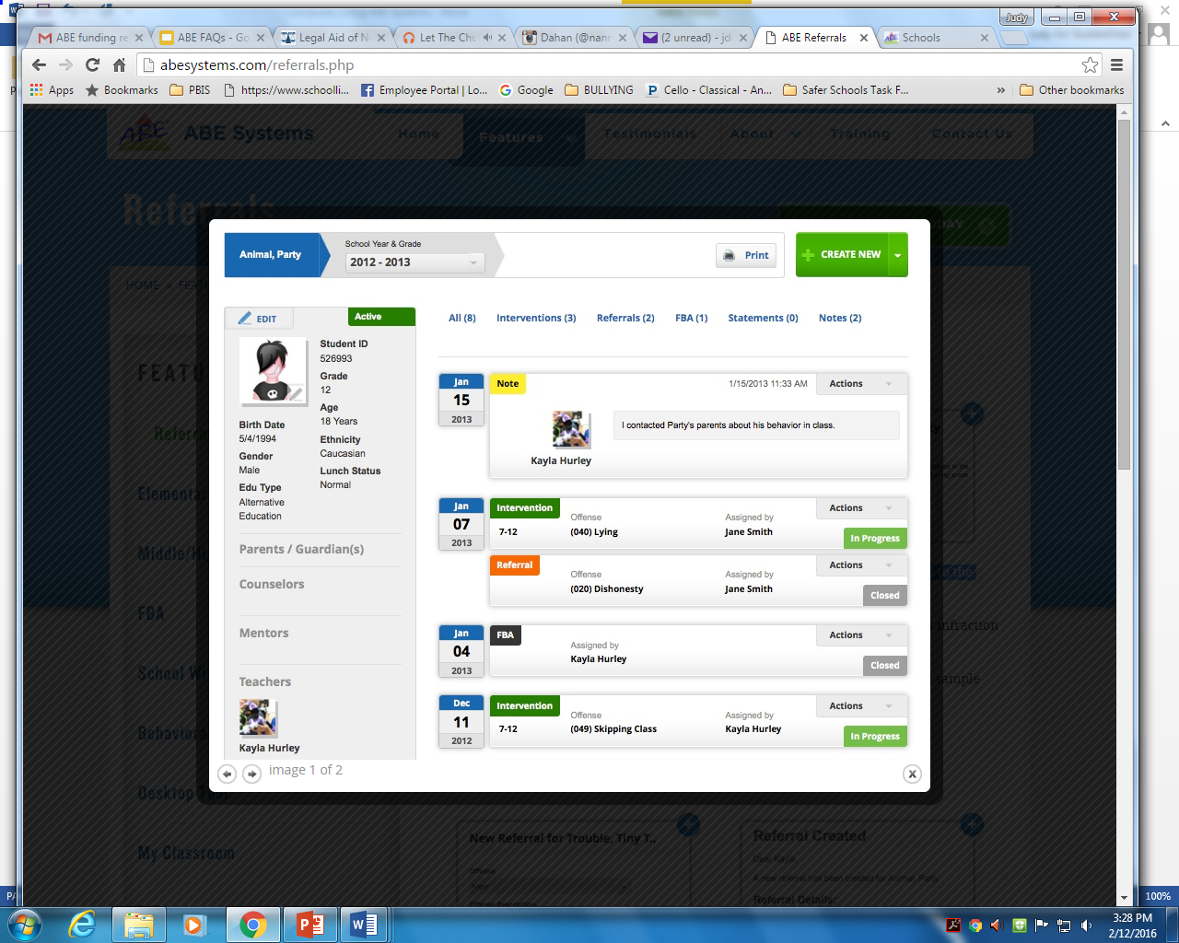
Quick Snapshot
Paperless system keeps Referrals, Interventions, FBA, and Notes connected to the student by keeping essential files organized and easily accessible.

Slide 8
Current Use
Used in all middle and high-schools, three elementary schools and will be used at the Suspension Center.
Allows for the managing of anecdotal data that can not be entered into PS.
Provides a view of the number and types of referrals made by individual teachers to support assessing needs for professional development.
Allows teachers to document behavior occurring in class that does not rise to the level of an office referral so that more specific data can be provided for parent conferences.

Slide 9
PBIS
30% of campuses implementing

Slide 10
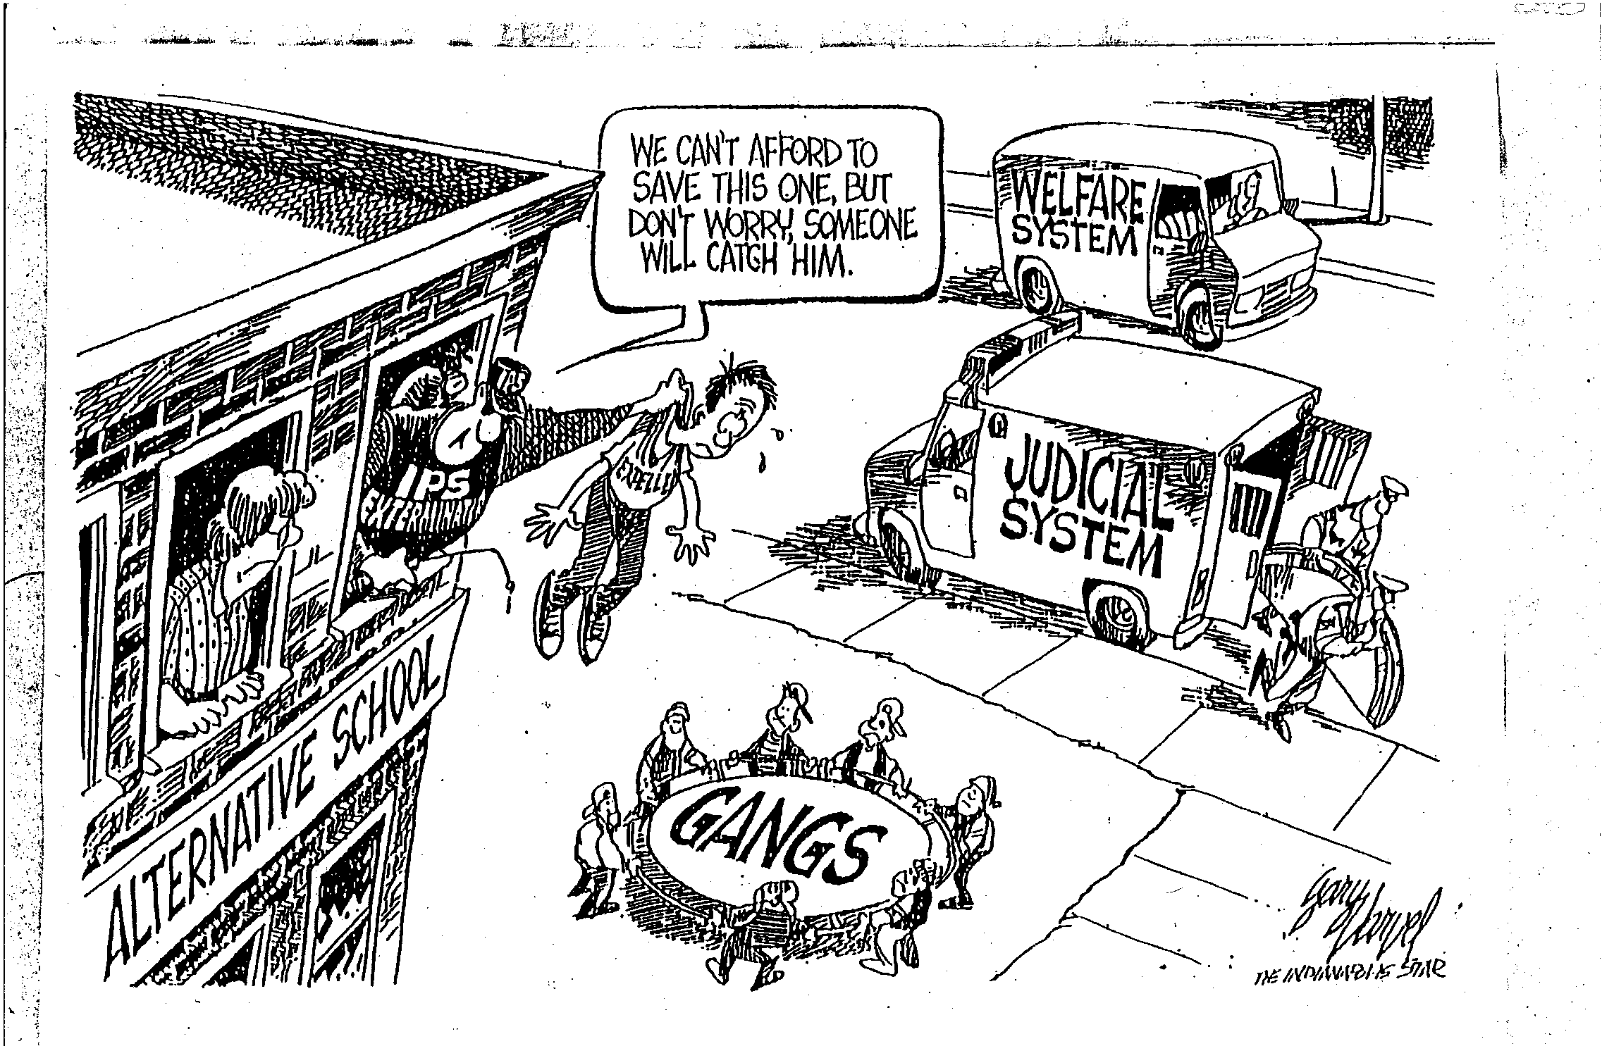
Why Positive Behavior Intervention
and Support?
Notes:
What reflections of the data do you see in your school & community?
Example: Teachers sometimes respond to student displays of chronic problem behavior by increasing use of verbal reprimands, exclusionary consequences (e.g., in school detention and out of school suspension), and loss of privileges. If student behavior does not improve, school systems typically increase their reactive responses by establishing zero tolerance policies, zero tolerance policies, increasing surveillance, posting security personnel and excluding students from school.
The over reliance on reactive management practices is a predictable outcome because teachers, parents, and administrators experience immediate reductions or removals of the problem behavior when they use strong aversive consequences. Having experienced reductions and relief from student problem behavior, they are more likely to use reactive management practices when future student problem behaviors reoccur, which is classic negative reinforcement (Sugai, et al, 2005, p 8).
Reference:
Sugai, G., Horner, R., Sailor, W., Dunlap, G., Eber, L., Lewis, T., Kincaid, D., Scott, T., Barrett, S., Algozzine, B., Putnam, B., Massanari, C., & Nelson, M. (2005). School-wide Positive Behavior Support Implementers’ Blueprint and Self-Assessment. OSEP Center on Positive Behavioral Interventions and Supports. Retrieved from http://www.osepideasthatwork.org/toolkit/pdf/SchoolwideBehaviorSupport.pdf

Slide 11
Bullying Prevention

Slide 12
Reporting is Encouraged and Investigated
Data for 2014-2015 School Year
All campuses have designated bullying investigators
Middle Schools have the highest numbers of reports
Bullying reporting information for parents, students and staff can be found under the parent tab on our district webpage along with our district policy and an informational tool for parents – Exploring Safe Ways to Use Technology.

Slide 13
First Steps Towards Implementation

Slide 14
Getting the Word Out
Building Level Administrators
New Avenues via Dropout Prevention Work Groups
                Safer Learning Environments
          2 Goals
        Establishing Campus Protocols for SROs
      What we need. What they need
    What do they do?
      Helping the community to understand - PR

Slide 15
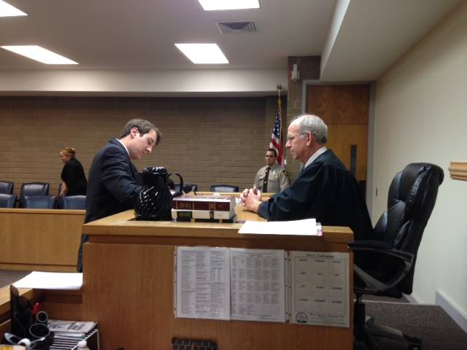
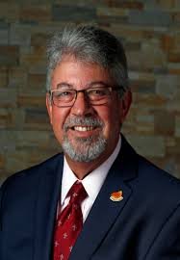
Restorative Practices Training
Attorney Jon Powell who serves as the director of the Restorative Justice Clinic of Wake County Schools and the Capital Area Teen Court program. He is also a Professor at Campbell Law School
Judge Julius Corpening will initiate the training session with an overview of the Graduated Response Protocol.
Dr. Kim Cook of UNC-W – Coordinated this training for NHCS

Slide 16
To learn more about MOUs and Restorative Practices
Contact Information:
Hon. Julius H. Corpening II /Chief Judge /North Carolina State Court
District Court/District 5 /316 Princess Street Suite 519/ Wilmington, NC 28401
Dr. Kimberly Cook / Bear Hall 228 / cookk@uncw.edu
Jon Powell / Director, Restorative Justice Clinic /jonpowell@campbell.edu
Dr. Janna Robertson /Watson College of Education/ robertsonj@uncw.edu

