Slide 1
New Hanover and Pender County North Carolina Safer Schools Task Force Recommendations
Presented by
Dr. Janna Siegel Robertson
University of North Carolina, Wilmington

Slide 2
Framework for Successful Schools
Representatives from the national associations of school principals, guidance counselors, psychologists, social workers, and resource officers. (2013)
Strong leadership/ flexibility resource allocation
Team-based facilitation
Physical and psychological safety
Trained mental health and safety personnel
Ongoing professional development
Multi-tiered system
Partner with families and community
Purpose: Teaching and learning
http://www.nasponline.org/resources/handouts/Framework_for_Safe_and_Successful_School_Environments

Slide 3
N.C. Center for Safer Schools Report to the Governor
Referred to the National Framework
National and state reports recommend that a local collaborative should make own community/district implementation decisions
Emerging theme: Importance of relationships
https://www.ncdps.gov/div/JJ/CenterForSaferSchoolsReport2013-web(1).pdf

Slide 4
Report Organization
Personnel
Programs
Process
Physical

Slide 5
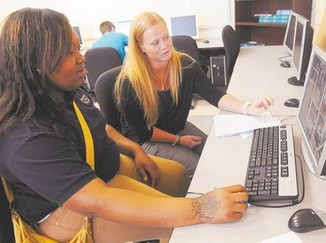
Personnel Recommendations
Safer Schools Leadership
Adequate Personnel and Appropriate Caseloads
School Psychologists, Counselors, Social Workers, Nurses, Teachers, Principals
School Resource Officers (SROs)
Adults in the Schools
Preparation and Training
Parent/Family/Student Collaboration and Training

Slide 6
Program Recommendations
School Climate and Behavior Management Systems
Health Services
Evidenced Based Programs
Targeted and Intensive Supports

Slide 7
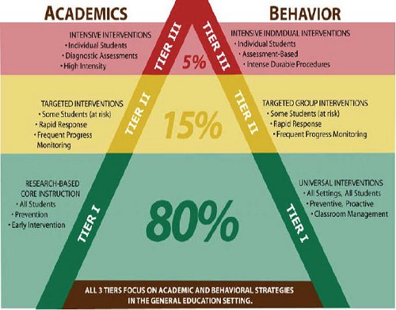
Process Recommendations
Implement Multi-tiered Systems of Supports (MTSS)
Successful MTSS requires:
Adequate resources
Trained appropriate numbers of
faculty/staff
Good transitioning between tiers
Address social, emotional, academic
services and supports
Reentry Transition Process
Fostering Relationships

Slide 8
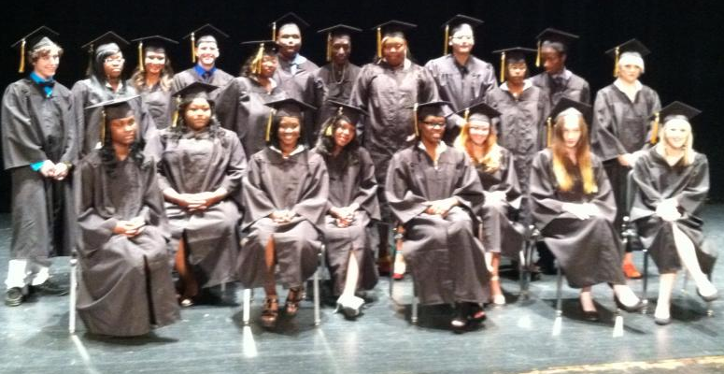
Task Force Formal Endorsements of Current Initiatives
Guidance Standards
Physical Plant Recommendations
School Volunteer Procedures
Judge Teske: Breaking Schoolhouse to Jailhouse Pipeline
Teen Court
Comprehensive Safety Awareness Training

Slide 9
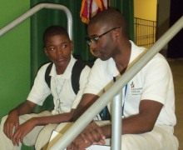
Conclusions: Relationships
Bill Milliken’s Five Basics for Communities in Schools are:
A one on one relationship with a caring adult
A safe place to learn and grow
A healthy start and a healthy future
A marketable skill to use upon graduation
A chance to give back to peers and community
A young man who brought a rifle into school, killing two students and wounding several others, told us from his prison cell: “I was really hurting. I didn’t have anyone to talk to. They just didn’t care.”

Slide 10
Safer Schools Task Force Members
Andy Atkinson Community Facilitator
Tom Barth MPA Faculty Facilitator, UNCW
Donald Berger Headmaster, Cape Fear Academy
Larry Bonney Retired FBI Special Agent, former Director in the National Center for Missing and Exploited Children
Kenneth Bowen Chief Officer for Student Learning & Accountability, Pender County Schools
Terri Cobb Superintendent, Pender County Schools
J. Corpening Chief District Court Judge
David Hand Social Worker, Laney High School
Stephanie Kraybill Past President, PTA
Warren Lee Director, New Hanover County Emergency Management
Beth Looney MPA Graduate Assistant, UNCW
Wanda Marino NHC Department of Social Services Assistant Director
Barren Nobles Lead Administrator, Wilmington Christian Academy
Deloris Rhodes Outreach Liaison, UNCW Watson College of Education
Janna Robertson Faculty Researcher, UNCW Watson College of Education
Bob Speight Chief Court Counselor - 5th District
Dave Spencer Safety Director, New Hanover County Schools
Judy Stubblefield Behavior Support Specialist, New Hanover County Schools
Amy Valimont Director of Integrated Care, Wilmington Health Access for Teens
Samantha Williams MPA Graduate Assistant, UNCW

